Slide 2
Alan Edwards SOAP prepared for professor Krasso
6th | May| 2019

Slide 3
contents
WHAT SOAP IS
ENVELOPES
HEADERS
FAULTS AND FAULT CODES
END-TO-END DATA FLOW OF A SOAP API

Slide 4
01.
WHAT SOAP IS

Slide 5
SOAP
SIMPLE OBJET ACCESS PROTOCOL (SOAP) IS A messaging system for encoding information into an xml document. Typically, it's a more specific way to to interpret a remote parameters values at runtime and placing those values into an xml document. SOAP can be carried over a variety of lower-level protocols, including the web-related Hypertext Transfer Protocol (HTTP).

Slide 6
KEY FEATURES
LIGHTWEIGHT STRUCTURE
LANGUAGE AGNOSTIC
USES XML TO STRUCTURE DATA
REQUESTS ARE SENT USING HTTP

Slide 7
02.
ENVELOPES

Slide 8
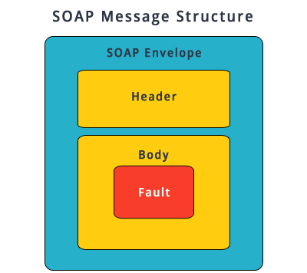
WRAPPER
THE ENVELOPE SERVES AS A WRAPPER FOR THE INFORMATION INSIDE. ITS AN ELEMENT THAT STARTS AND ENDS THE MESSAGE DISPLAYED.

Slide 9
PURPOSE
USED AS A WRAPPER OF THE DATA BEING SENT TO THE WEB SERVICE
CONTAINS HEADER AND BODY ELEMENTS
CONTAINS ATTRIBUTES THAT DEFINE ENCONDING FEATURES

Slide 10
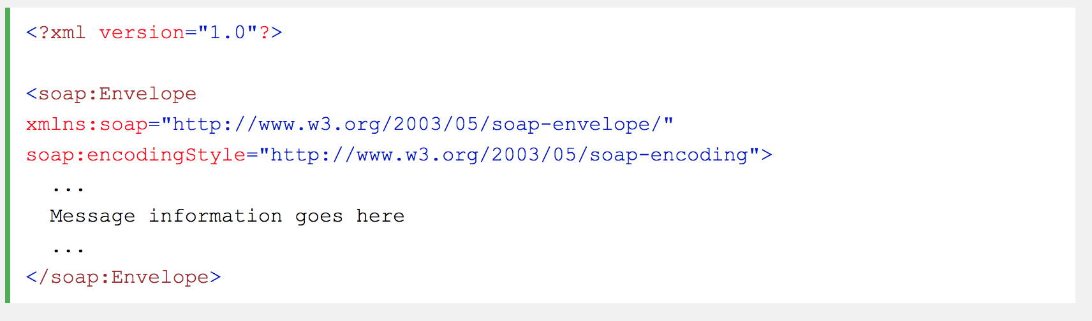
example

Slide 11
03.
HEADERS

Slide 12
HEADERS
In information technology, a header is, in general, something that goes in front of something else and is usually repeated as a standard part of the units of something else. A header can consist of multiple FIELDS, each containing its own value.

Slide 13
Overview
• Optional element and is not always present or included
Header element provides additional important information that is not in the body of the request
Authentication, transaction and payment methods are sometimes contained within the header

Slide 14
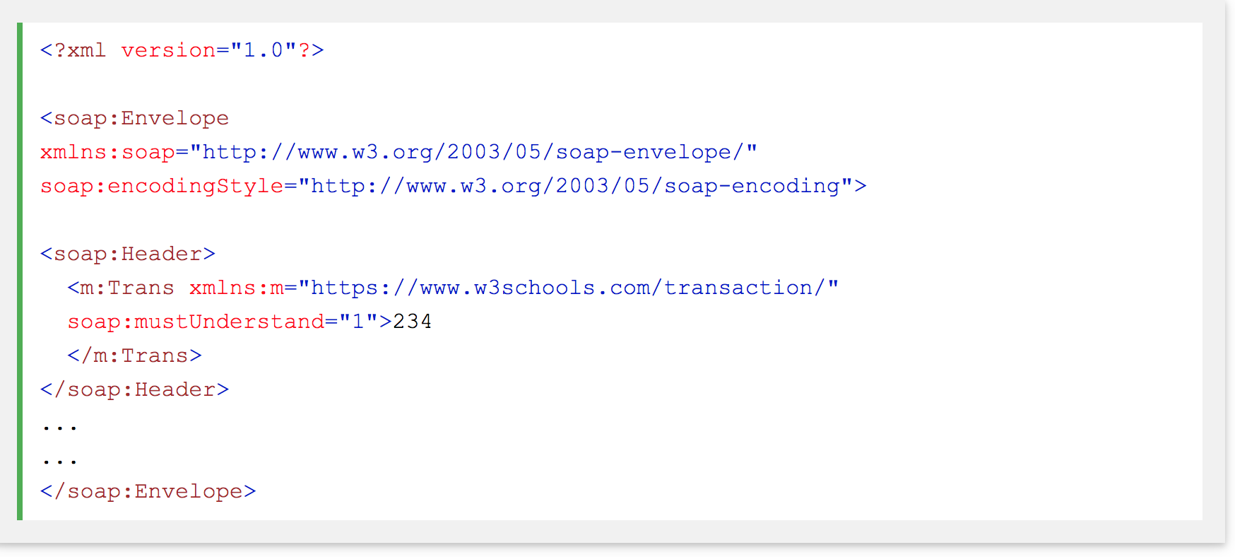
example

Slide 15
04.
FAULTS AND
FAULT CODES

Slide 16
Overview
Fault elements contain information about the errors that occur when processing a request and identify where the error occurred.

Slide 17
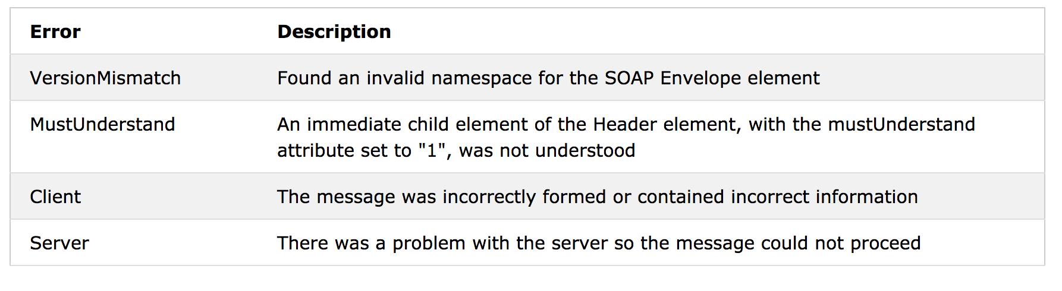
Fault codes

Slide 18
05.
END-TO-END
DATA FLOW OF
A SOAP API

Slide 19
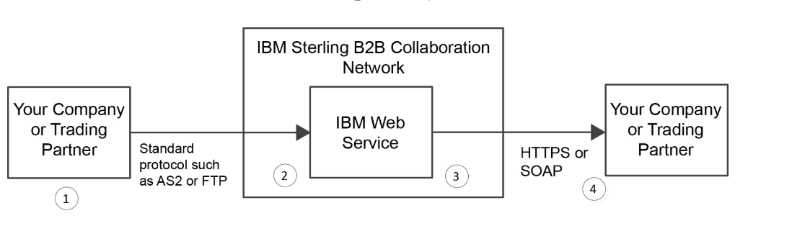
Outbound Flow
When HTTPS or SOAP is used to send business documents, this is referred to as outbound data flow. At a high level, the outbound data flow for the SOAP gateway is as follows the diagram to the right

Slide 20
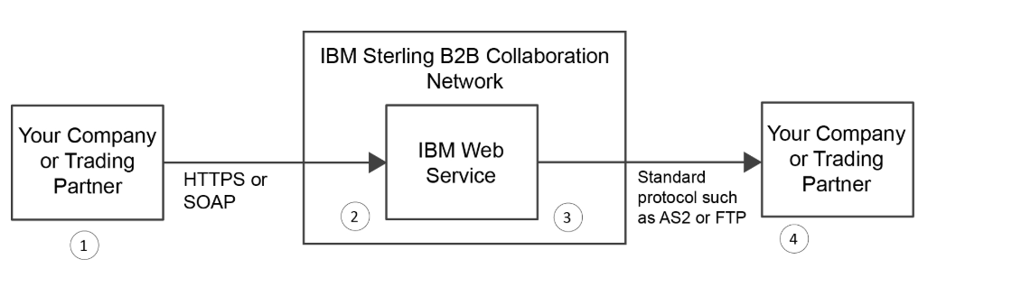
inbound Flow
When HTTPS or SOAP is used to receive business documents, this is referred to as inbound data flow. At a high level, the inbound data flow is as follows the diagram to the right

Slide 21
ALAN EDWARDS WEB DEVELOPMENT STUDENT ALAN.EDWARDS1103@GMAIL.COM

Slide 22
Sources

Slide 23
chrome-extension://oemmndcbldboiebfnladdacbdfmadadm/https://content.bellevue.edu/cst/WEB/WEB420/Week%203/SOAP%20Article.pdfhttps://searchmicroservices.techtarget.com/definition/RESTful-API
https://searchmicroservices.techtarget.com/definition/SOAP-Simple-Object-Access-Protocol
https://www.google.com/url?sa=i&source=images&cd=&ved=2ahUKEwi3uZPBvp7iAhXvRd8KHdK4CXEQjB16BAgBEAQ&url=https%3A%2F%2Fwww.codenuclear.com%2Funderstand-soap-message-structure%2F&psig=AOvVaw0l3xmUjw3owEZ7MMYY08lV&ust=1558042427087392
https://www.w3schools.com/xml/xml_soap.asp
https://www.ibm.com/support/knowledgecenter/en/SSRJDU/gateway_services/soap/SCN_WSG_Protocol_DataFlow.html

